Slide 1
مبانی عصب شناسانه ی رفتار و یادگیری

Slide 2
Outline
Introduction
Action control in Behavior
Motivation in Behavior
Integration of action control and motivation
Learning
Summarization

Slide 3
Introduction

Slide 4
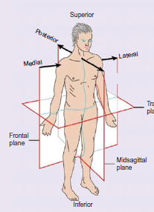
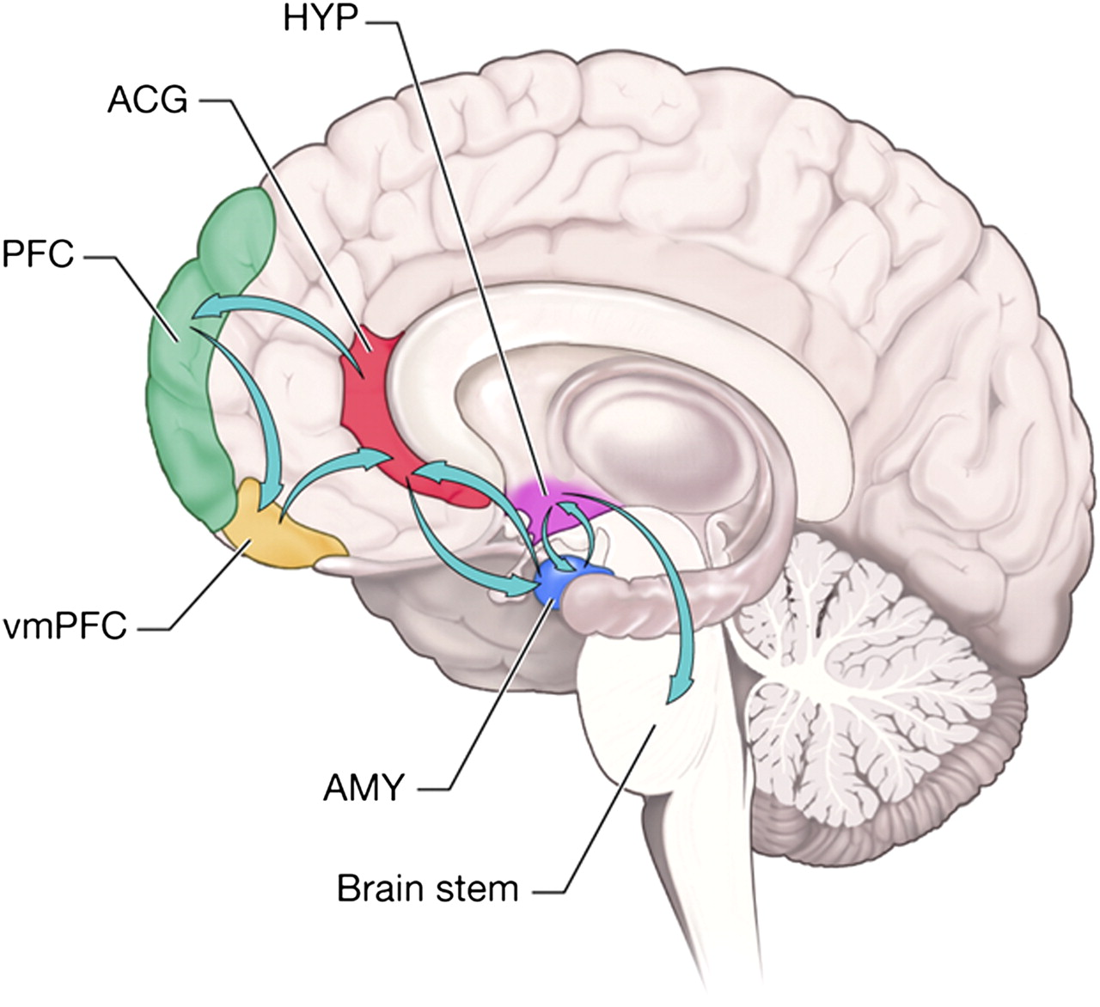

Slide 5
Action control in Behavior
Behavior types
Goal Directed
Acton and Reward relation
R-O process
Habitual
Reactive
Stimulus and Respond relation
S-R process
Detecting methods
Outcome devaluation test
Contingency degradation test
Why habitual routines are important?

Slide 6
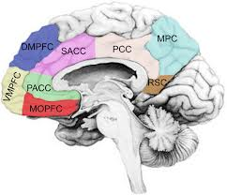
Action control in Behavior Goal-Directed
vmPFC and OFC acivity and expected reward
vmPFC and OFC’s correlation with Outcome devaluation
mPFC’s correlation with Contingency degradation

Slide 7
Action control in Behavior Goal-Directed
Dorsal Striatum
Dorsomedial activity
PFC in Learning and Decision making,
Dorsal striatum in learning and performance

Slide 8
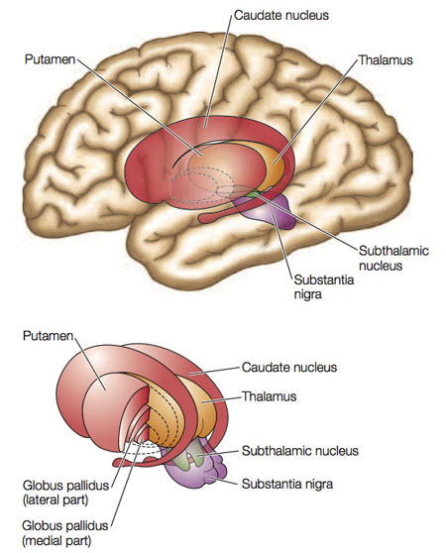
Action control in Behavior Habitual
Lateral striatum
Dorsolateral striatum
Transmission to posterior parts

Slide 9
Motivation in Behavior
Motivation activate action and modulate its intensity
Amygdala, Accumbens, PFC
Influence on Behavior
Goal-directed: Drive, action selection
Habitual: more influence (e.g. chain actions)
Just affected on assigned behavior
Assign and Initiation:
Intrinsic
Pavlovian conditioning

Slide 10
Motivation in Behavior Neural basis
Amygdala:
Basolateral Amygdala (BLA)
Lesions decrease outcome devaluation
Efferent to PFC and Accumbens(core)
Central Amygdala
Connection with Hypothalamus and some body senses
Hypothalamus connection with Brainstem, medial thalamic nuclei and cortex
Cooperation of Central and Basolatertal provide classic conditioning

Slide 11
Motivation in Behavior Neural basis
Nucleus Accumbens:
Shell:
Connection with Hypothalamus and VTA
Learning Process
Core:
Connection with afferent Dopaminergic neurons, Glutamatergic neurons of PFC and efferent GABAergic to ventral Pallidum
Performance process, not learning (Outcome evaluation and Contingency degradation in goal-directed )

Slide 12
Motivation in Behavior Neural basis
Prefrontal Cortex:
Anterior Cingulate Cortex(ACC) and Orbifrontal Cortex(OFC)
Correlation of mOFC activity with outcome value and motivation such as Drive
Relate between “Representation of action” and “Representation of outcome” , in contrast of BLA

Slide 13
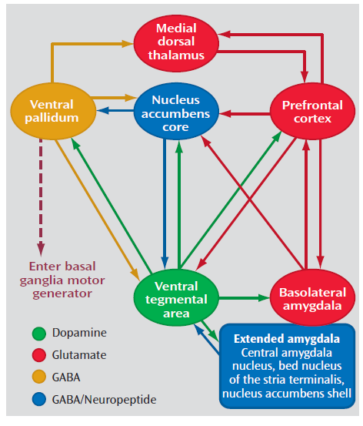
Motivation in Behavior Neural basis
Activation Circuit:
Direction of action?
PFC and Accumbens core

Slide 14
Motivation in Behavior Assign and Initiation
Intrinsic
Pavlovian conditioning:
Amygdala:
Central Amygdala: intensity
Basolateral Amygdala: Biasing
OFC:
Motivational relation between Stimulus and Reward
Mapping and detection
Accumbens:
Shell: Motivational relation between Stimulus and Reward
Core: Pavlovian-Instrumental Transition
Dopaminergic circuit

Slide 15
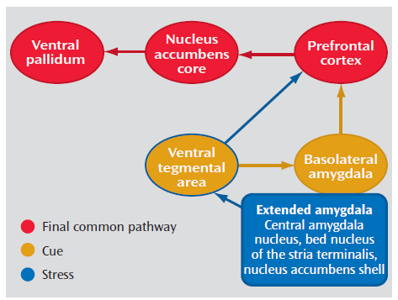
Motivation in Behavior Motivation types
Fear: mostley Amygdala
Hedonic: mostly Accumbens
Reward related: mostly Cortex
Motivation circuit:
Dopamine role

Slide 16
Integration of action control and motivation
Integration approachs:
Behavioral:
Computational:
Neural:

Slide 17
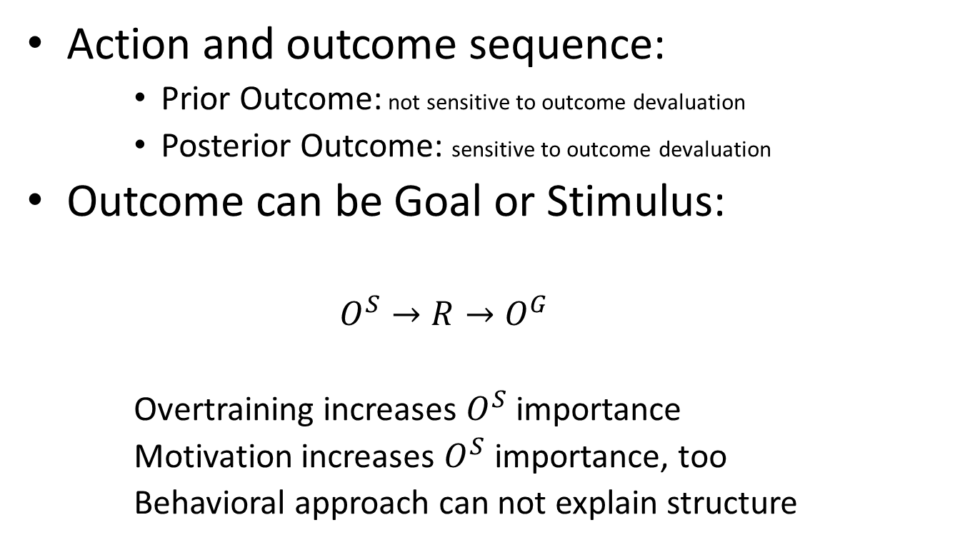
Integration of action control and motivation Behavioral
Action and outcome sequence:
Prior Outcome: not sensitive to outcome devaluation
Posterior Outcome: sensitive to outcome devaluation
Outcome can be Goal or Stimulus:
$$O^{S}→R→O^{G}$$
Overtraining increases $O^{S}$ importance
Motivation increases $O^{S}$ importance, too
Behavioral approach can not explain structure

Slide 18
Integration of action control and motivation Computational
Actor/critic model
Ventral striatum as critic(classic conditioning, S-O learning)
Dorsal striatum as actor(S-R and R-O learning)
No difference between goal-directed and habitual
second model(!)
Model-free for Habitual actions (dorsolateral striatum)
Model-based for Goal-directed (vmPFC, dorsomedial striatum)
Smaller uncertainty choose action
Contingency degradation, all-or-none, dopamine role in dorsal striatum and PFC, uncertainty evaluation is not consist with neural evidences

Slide 19
Integration of action control and motivation Computational
Third model(!)
All actions are model-free(in Basal Ganglia level)
PFC store and update goal-directed values
Dopamine neurons control “go”-”not-go” weights
Contingency degradation, lateral-medial dorsal striatum imagings

Slide 20
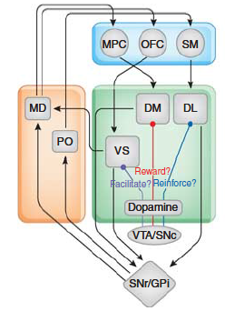
Integration of action control and motivation Neural
Habitual
Goal-Directed

Slide 21
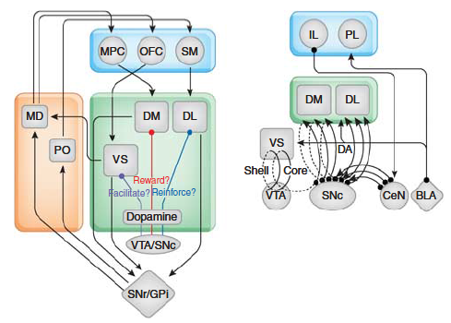
Integration of action control and motivation Neural

Slide 22
learning
Permanent changes in:
Memory (declarative and procedural)
Judging and Decision making
Motivations
Etc.
Long term learning must make long term changes in neural system’s function

Slide 23
learning
Dopamine role in learning:
Dopamine control Hedonic motivation and Classical conditioning, but it’s not the only way(e.g. in nicotine, alcohol, cannabis addiction)
More importantly, Dopamine mediates reward and it’s motivation relation
In RL discipline dopamine codes error signal:
Phasic activity as positive feedback
Tonic activity as zero feedback
Pause as negative feedback (not sufficient)

Slide 24
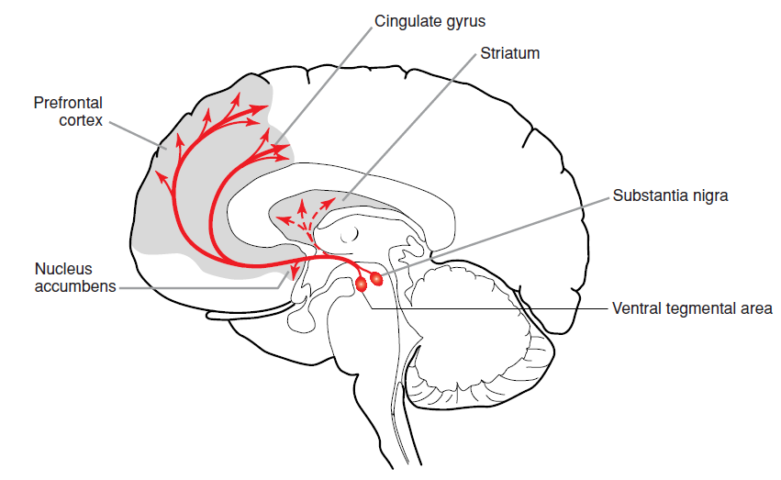
learning
Dopamine pathway:

Slide 25
learning
Leakage of Dopamine can code “value of goals” and “relation between stimulus and goals”
But can not connect them to behavior
Mapping from internal/external states and stimulus to action is needed

Slide 26
learning
Neural message transition
Synapses
Direct connections
Global messages
Indirect messaging with side effects

Slide 27
learning
Homeostatic changes deficiency in learning
Relapse after long withdrawal in addiction
Reinstatement effect in relapse
Long term Memory ,and etc.
Long term changes:
Structural (glia activity, or maturation)
Functional (synaptic adaption)
Hebbian specific synaptic adaption

Slide 28
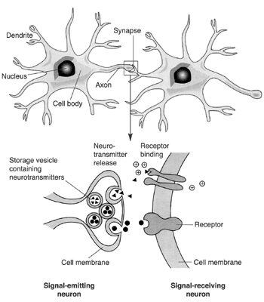
learning
Synaptic message transmission

Slide 29
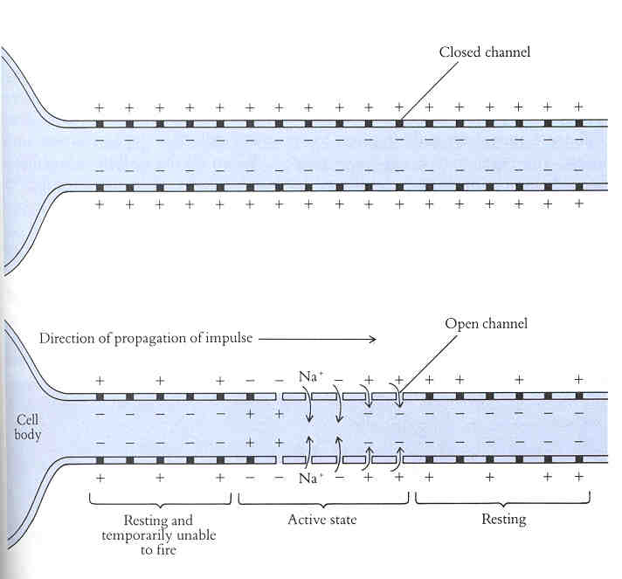
learning
Synaptic message transmission

Slide 30
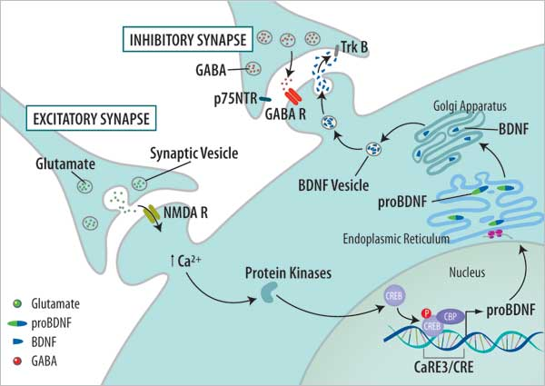
learning
Short term and long term changes in synaptic plasticity

Slide 31
learning
In addiction

Slide 32
summarization

